Slide 1


Hope to Skills
Lecture# 31
Irfan Malik, Dr. Sheraz Naseer

Slide 2
Agenda
Document GPT
Steps to make document GPT
LangChain
Vector Embeddings
Vector DataBase
Chatbot

Slide 3
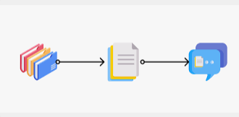
Document GPT

Slide 4
Document GPT - Functionality
User can upload the Document
He can Query anything from the document
User can generate summary of the document

Slide 5
Required Tools
LLM (openai)
Langchain
Vector database
Streamlit

Slide 6
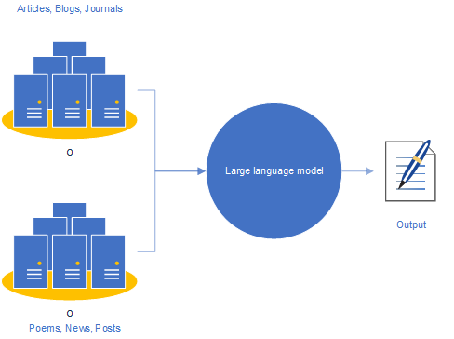
Openai

Slide 7
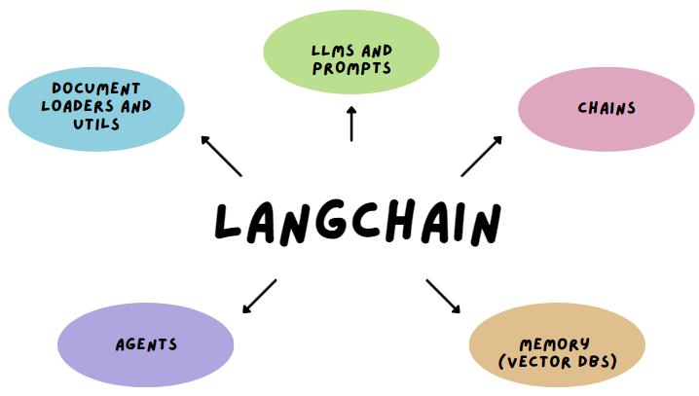
Langchain
LangChain is an open-source framework designed to simplify the creation of applications using large language models (LLMs).
It can be used for task like
Chatbots
Answering questions using sources
Data Augmentation.

Slide 8
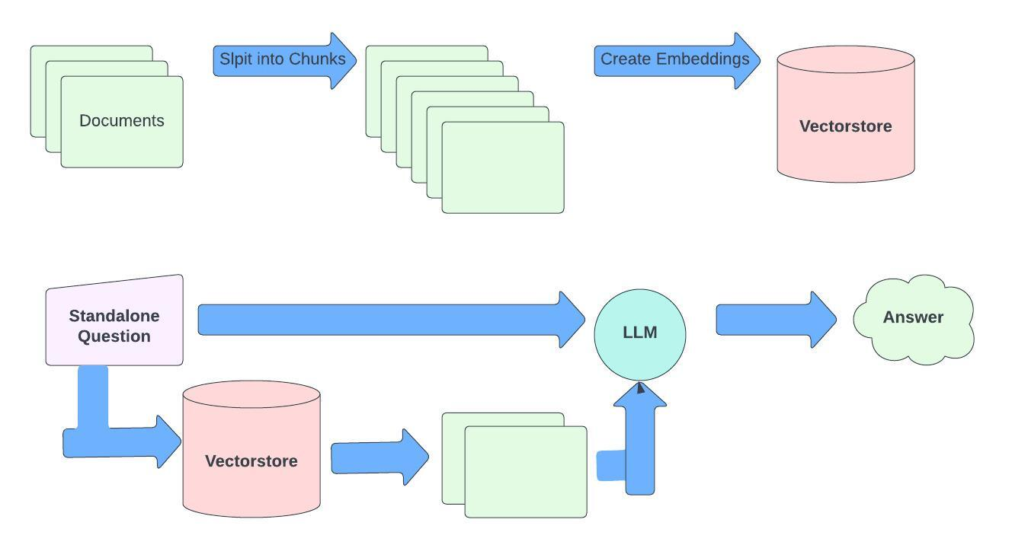
Document GPT

Slide 9
Steps for Chatbot
Answering questions from a document involves the following steps:
Splitting the document into smaller chunks.
Convert text chunks into embeddings.
Perform a similarity search on the embeddings.
Generate answers to questions using an LLM.

Slide 10
Document GPT

Slide 11
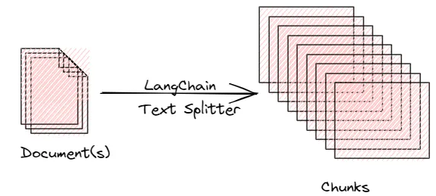
Splitting the document
The first step in answering questions from documents is to load the document. Lang Chain provides document loaders that can help load the documents

Slide 12
Why Splitting?
Due to the Token limit of Large Language models. gpt-3.5-turbo has the token limit of 4096
If your input prompt is 10 tokens and the model generates a response of 20 tokens, you would be using a total of 30 tokens

Slide 13
Document GPT

Slide 14
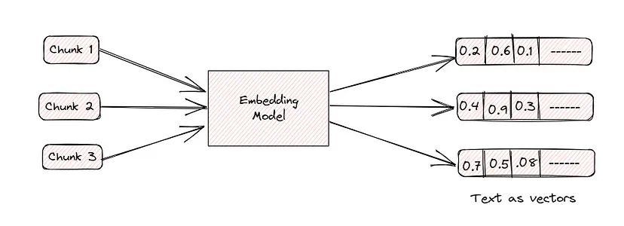
Chunks to Embeddings
Embeddings are numerical representations that capture the semantic essence of words, phrases, or sentences

Slide 15
Chunks to Embeddings

Slide 16
Embeddings Models
You can use the following embedding models
sentence-transformers/all-mpnet-base-v2 (free)
embed_model ="intfloat/e5-small-v2" (free)
OpenAI embeddings (paid)

Slide 17
Document GPT

Slide 18
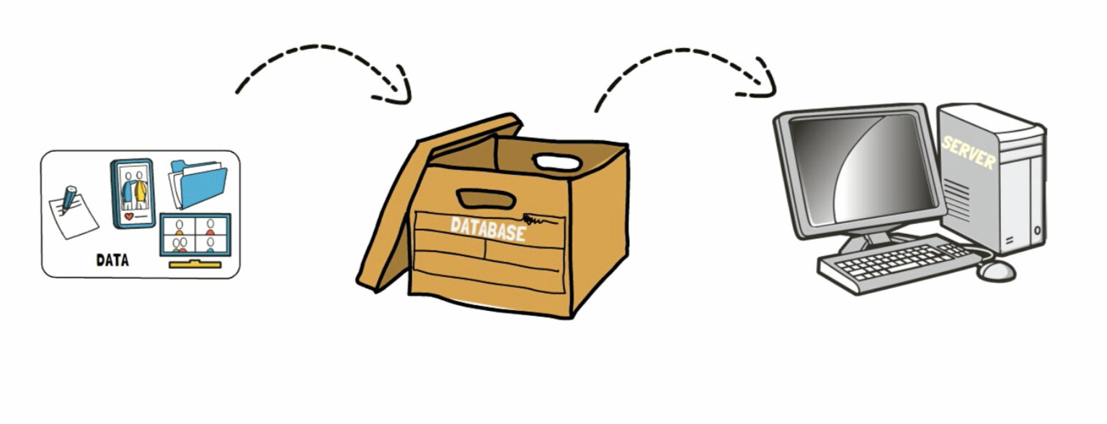
What is Database?

Slide 19
Vector Databases
A type of database optimized for handling vector data, often used in machine learning and analytics.
Vector Storage: Data stored as vectors or embeddings.
Vector Indexing: Efficient indexing of vector data.
Similarity Search: Finding vectors similar to a query vector.
High-Dimensional Data: Handling data with many dimensions

Slide 20
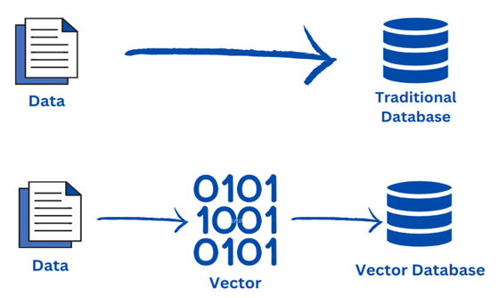
Difference Vector DB and Traditional DB

Slide 21
Vector Databases
Following are the options for vector databases
FAISS (locally managed)
Elastic Search (locally managed)
Chroma db (locally managed)
Quadrant (Managed)
Pinecone (Managed)

Slide 22
Document GPT

Slide 23
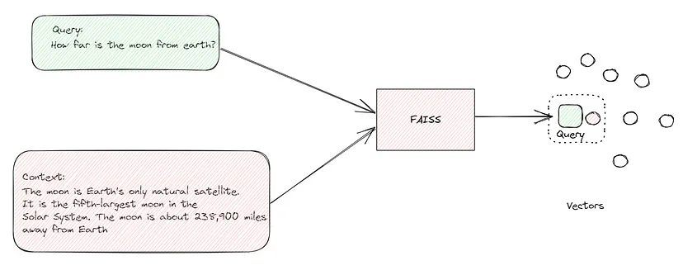
Similarity Search
Technique for finding the most similar items to a given item, where the items are represented as vectors in a high-dimensional space. This is done by measuring the similarity between the vectors.

Slide 24
Document GPT

Slide 25
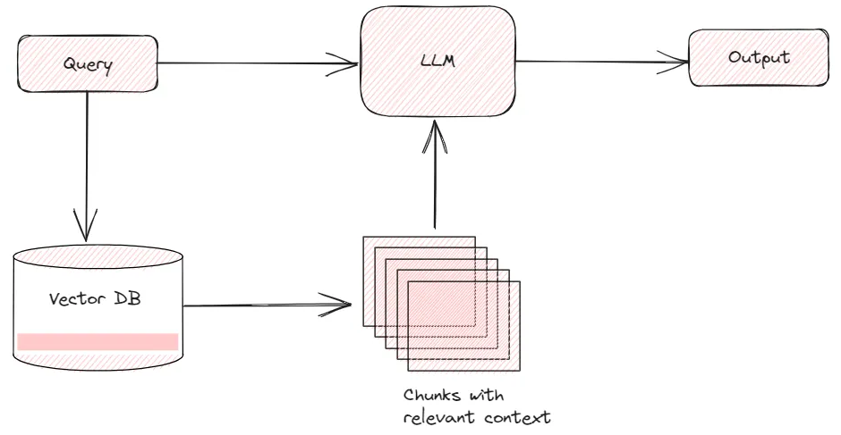
Answer Generations

Slide 26
Answer Generations
Once the most similar chunks have been found. Here is where LangChain shines as it pass the given the question and the most similar chunks as input it got from FAISS to the LLM. The LLM then uses the input to generate a text response that is relevant to the question.

